Slide 1
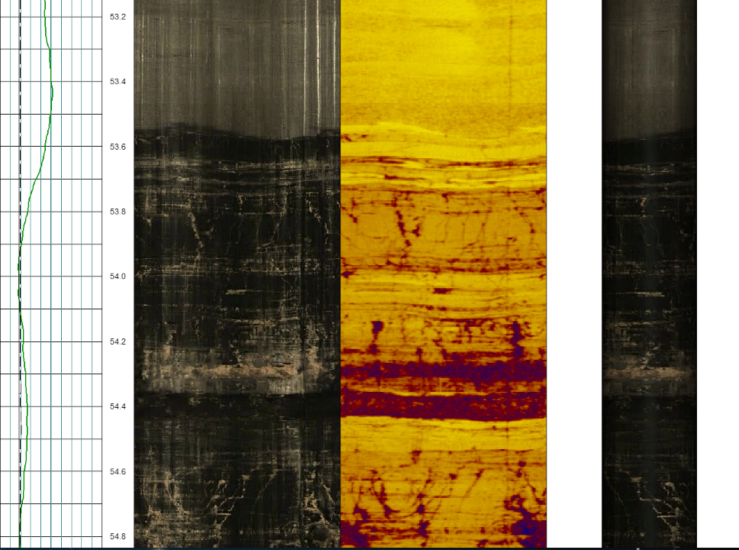
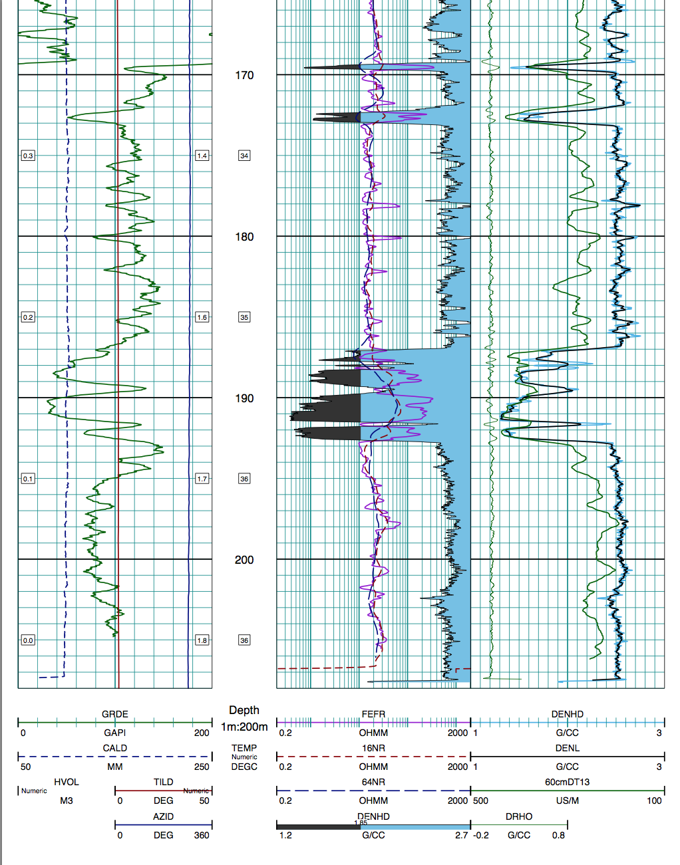

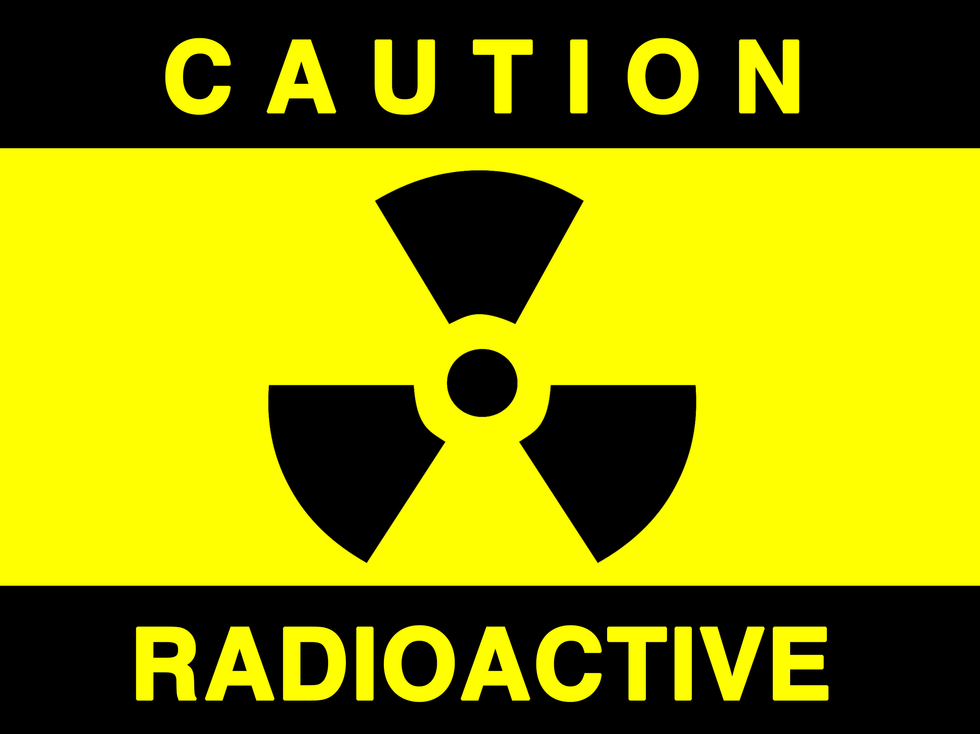

Radiation Safety

Slide 2

Why do we need radiation safety?
Some wireline logging tools use small sealed radioactive sources:
Cs137 - gamma-gamma density
Co60 - gamma-gamma density
Am241/Be - neutron logging tools
The energy released by the sources is relatively small, however strong controls to manage the hazards associated with these sources are mandated by Government.

Slide 3
Government regulations
Australia-wide Standards and Regulations
Code of Practice for the Safe Use of Sealed Radioactive Sources in Borehole Wireline Logging (1989)
Code of Practice for the Safe Transport of Radioactive Sources (1990)
Western Australian Regulations
Radiation Safety Act (1975-1999)
Radiation Safety - General (1983-2000) and Transport of Radioactive Substances (2002)

Slide 4
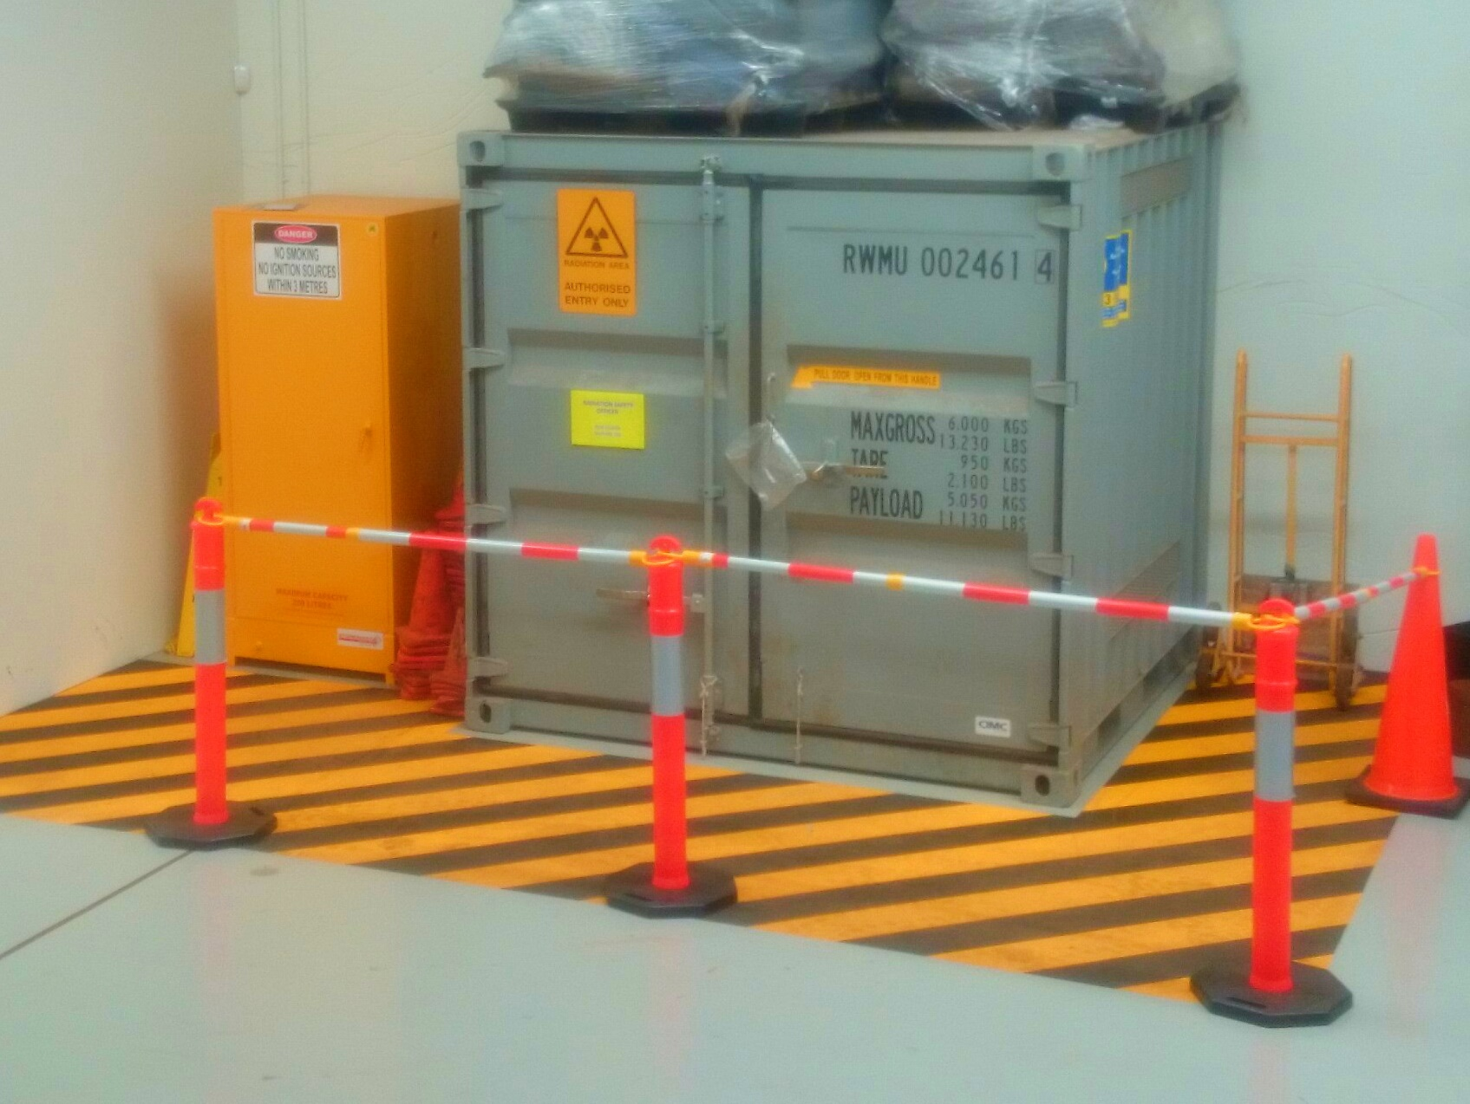
Statutory Obligations
License to own and use radioactive sources.
Appointment of a Radiation Safety Officer.
Maintain a Radiation Safety and Protection Plan to the satisfaction of the Radiological Council (WA)
Ensure all users adequately trained in safe handling of radioactive sources
Maintain and keep records of personal protective devices and dose monitors for all users
Ensure safe storage and handling procedures to ensure dose is below specified thresholds (ALAR)

Slide 5
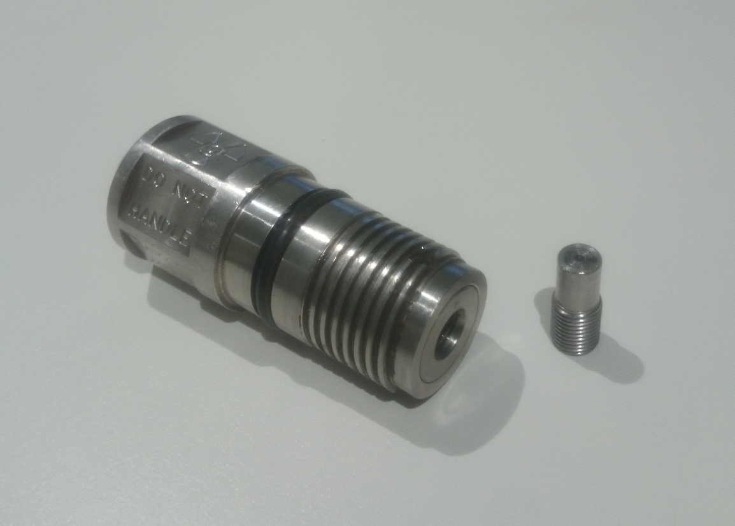
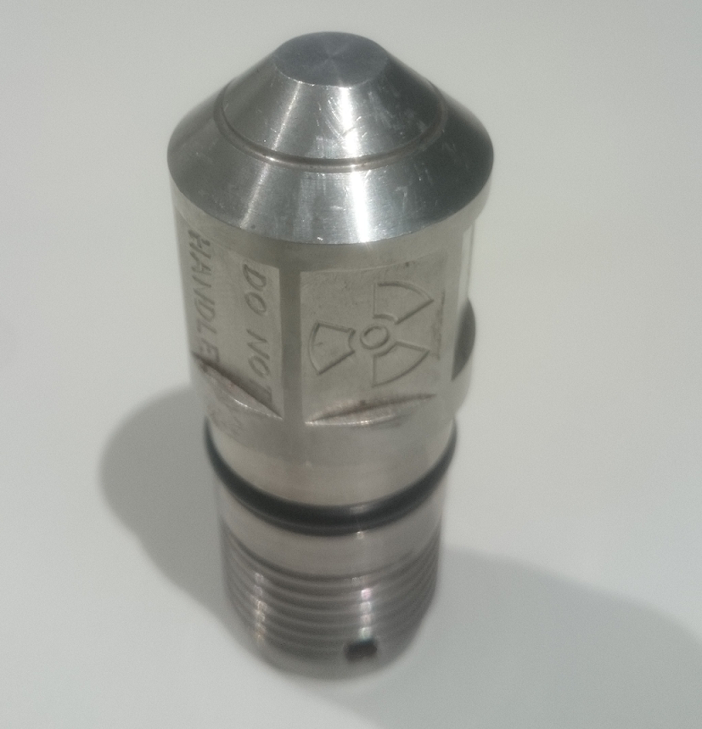
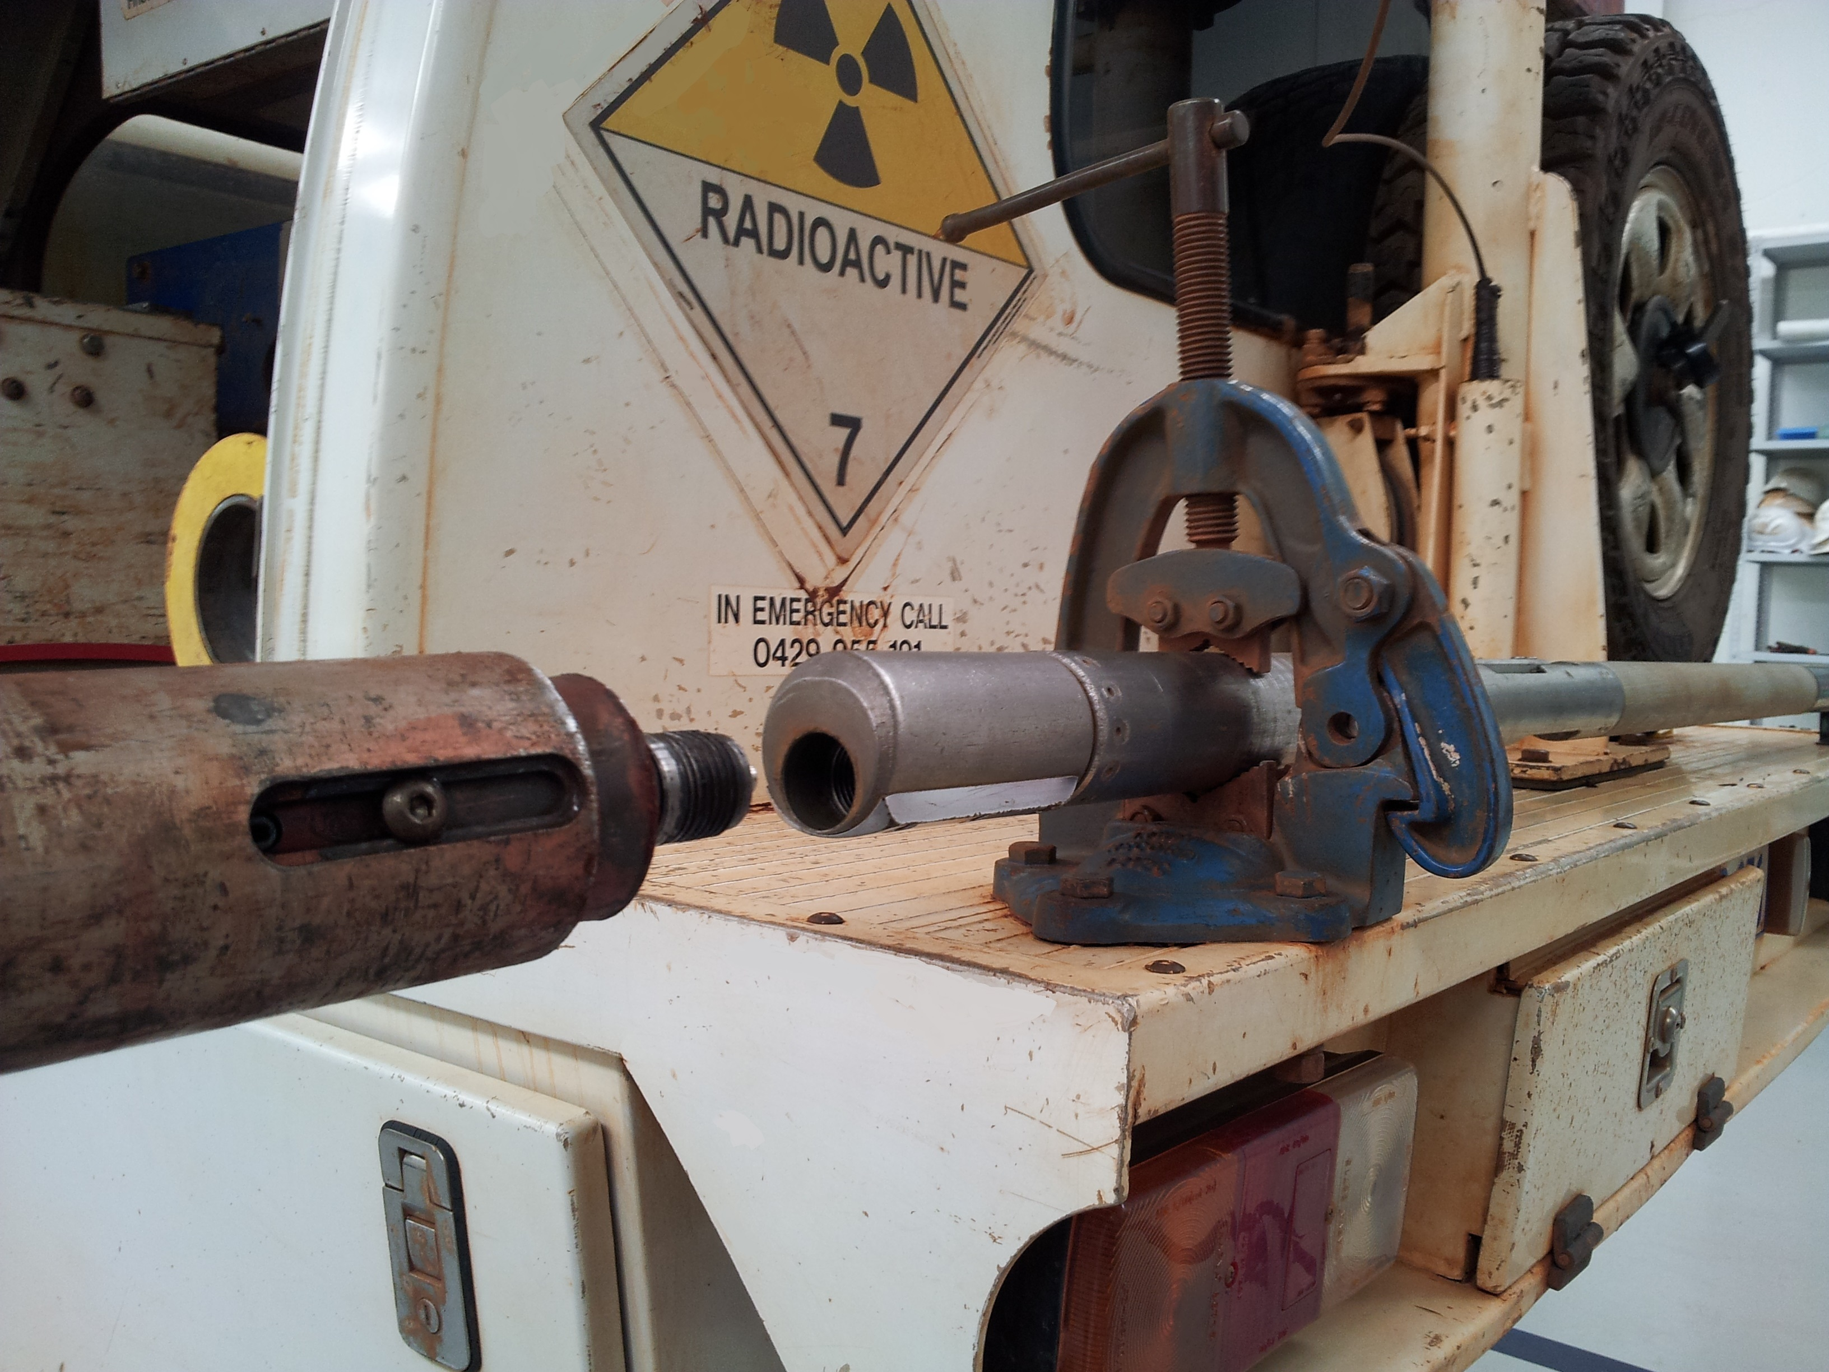
Fitting the source into a tool

Slide 6
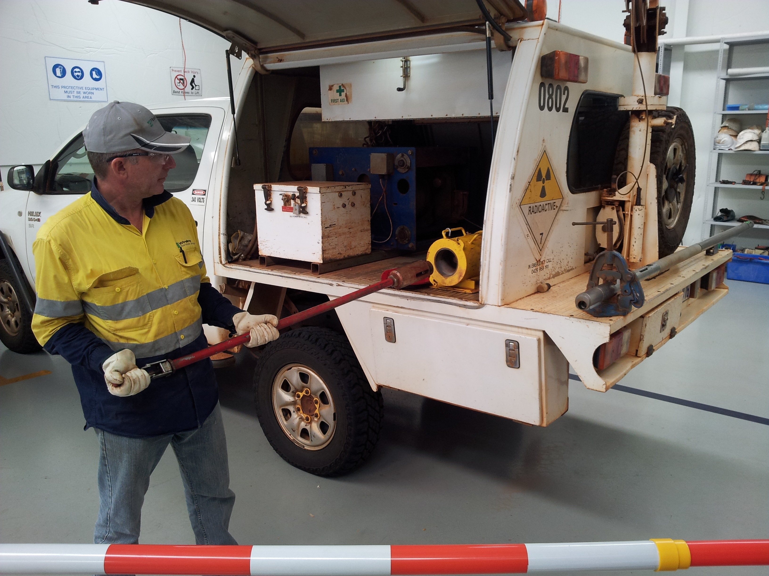
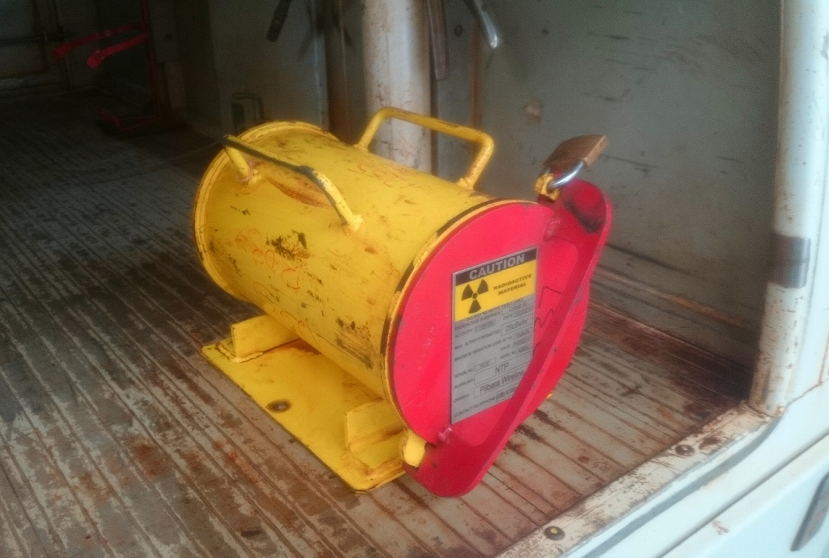
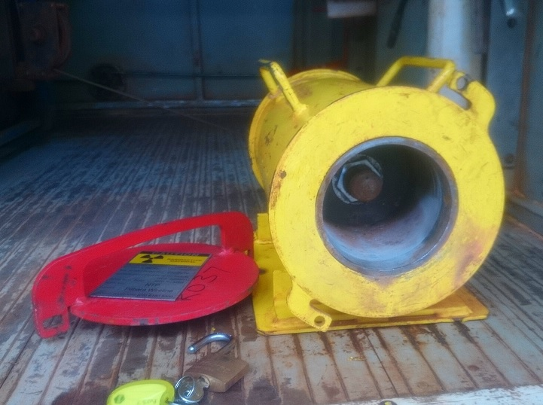
Key Principals to minimise exposure
Time
Distance
Shielding

Slide 7
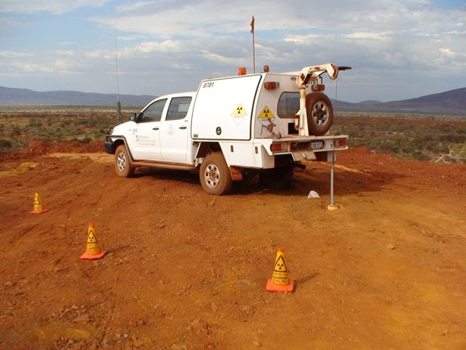

Keeping others safe
Warning signs
Exclusion zone

Slide 8
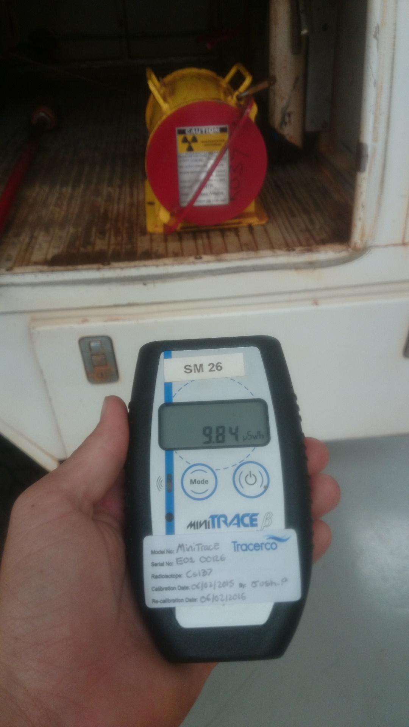
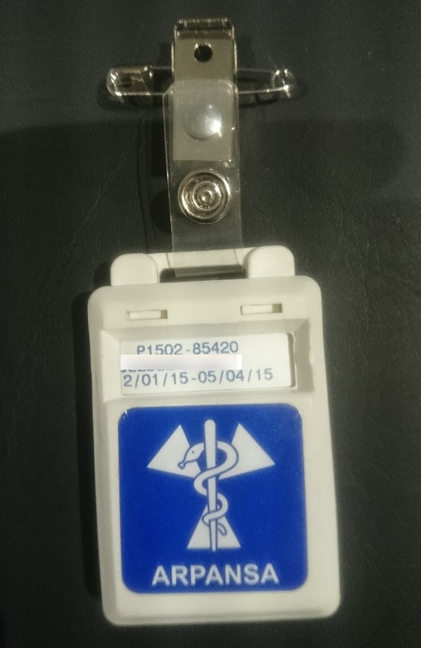
Personal monitoring devices

Slide 9
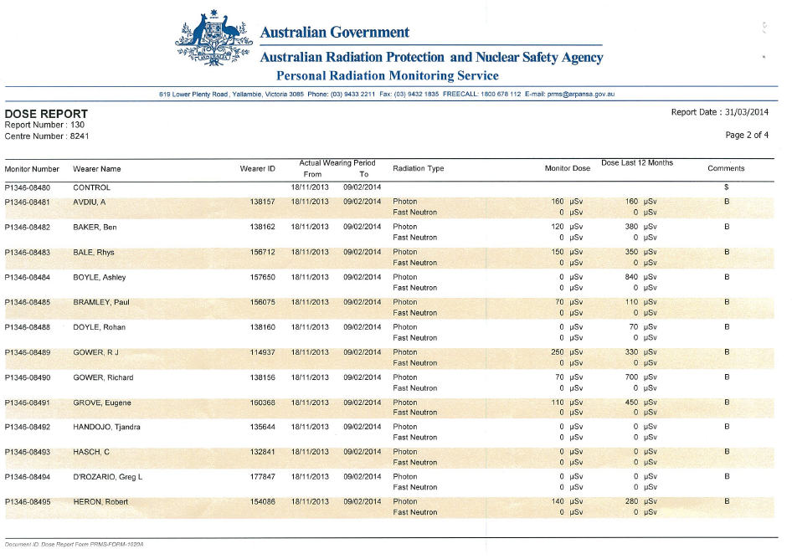

Record keeping
Max. annual dose
50,000 µSv/y

Slide 10
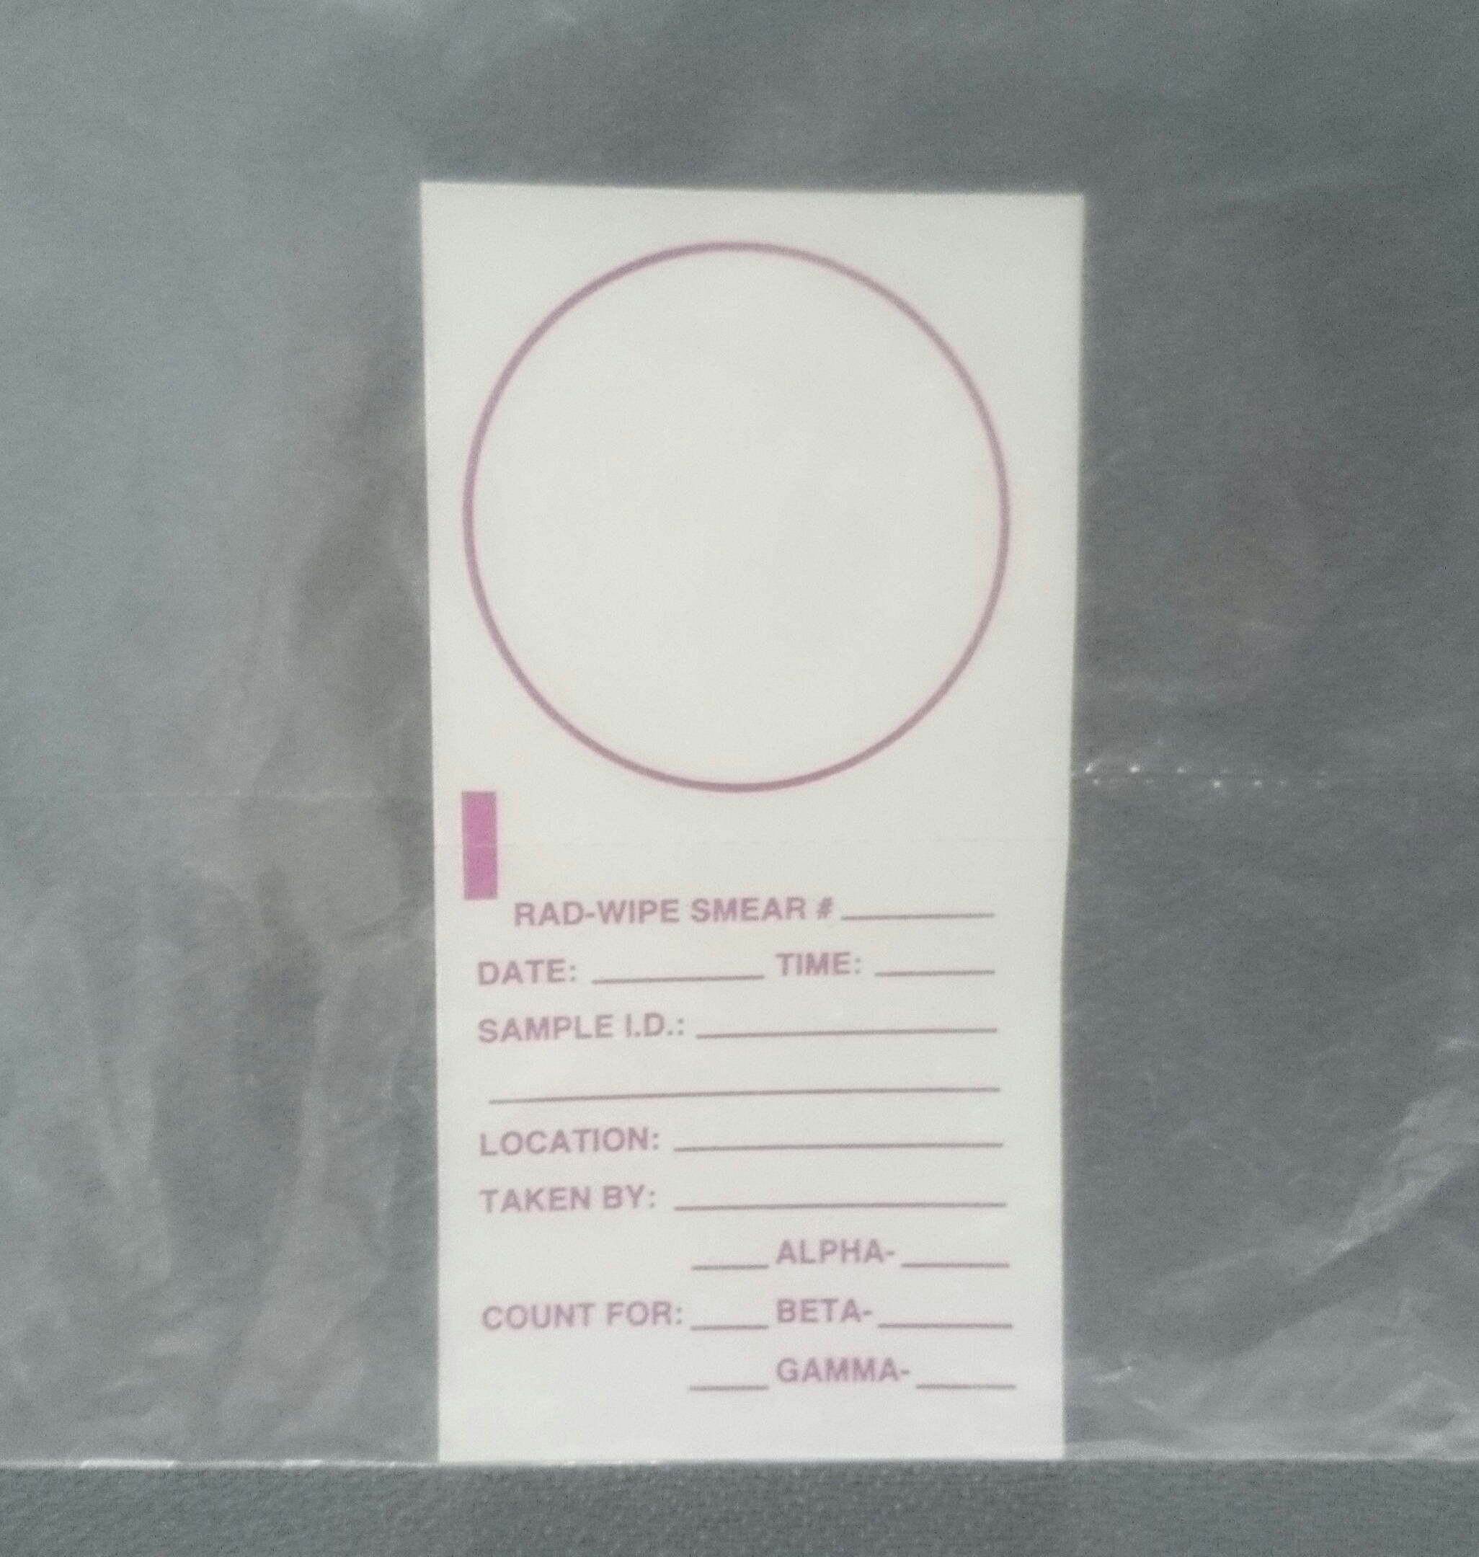
Testing

Slide 11
Final comments

